Slide 1
DE-2 Project: Digital clock
Members: David Corrionero, Aitana del Carmen, Oier Dorado

Slide 2
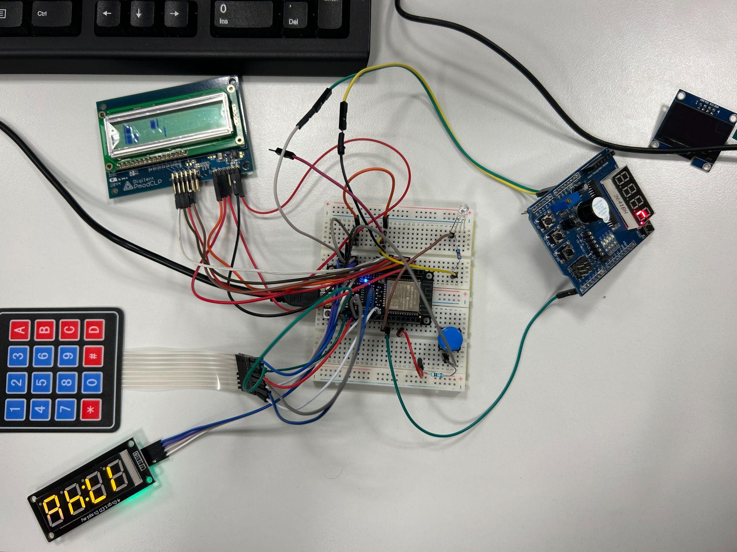

Slide 3
LCD DISPLAY
LED DISPLAY

Slide 4
KEYPAD
BUTTON
LED
BUZZER

Slide 5


Slide 6
Thank you for your attention

